Slide 1

An end-to-end SaaS to evaluate
MENTAL HEALTH
TEAM 65
CILI

Slide 2



SCOPE OF THE PROBLEM
What's the gap between understanding one’s onset of symptoms and seeking treatment?
1/4th of the World's Population experience mental health illness
193 billion $ in lost wages annually
1 Trillion $ in GDP
INDIA
CHINA
56 Mn
54 Mn
US $1
Put into treatment of common mental disorders
Depression
38 Mn
41 Mn
Anxiety
Disorders
US $4
Return in improved health and productivity
UN SDG #3 Good Health & Well Being
Ensure healthy lives and promote well-being for all at all ages.

Slide 3




THE TEAM
Yaser Ahmad Palikonda Latheef
MBA candidate
Italy & India
Amal Masri
Premed Biology
Lebanon
Shashwat Drolia
Artificial Intelligence
India
Samantha Zhan
Computer Science
Canada & China
Y
.
A
.
S
.
S

Slide 4
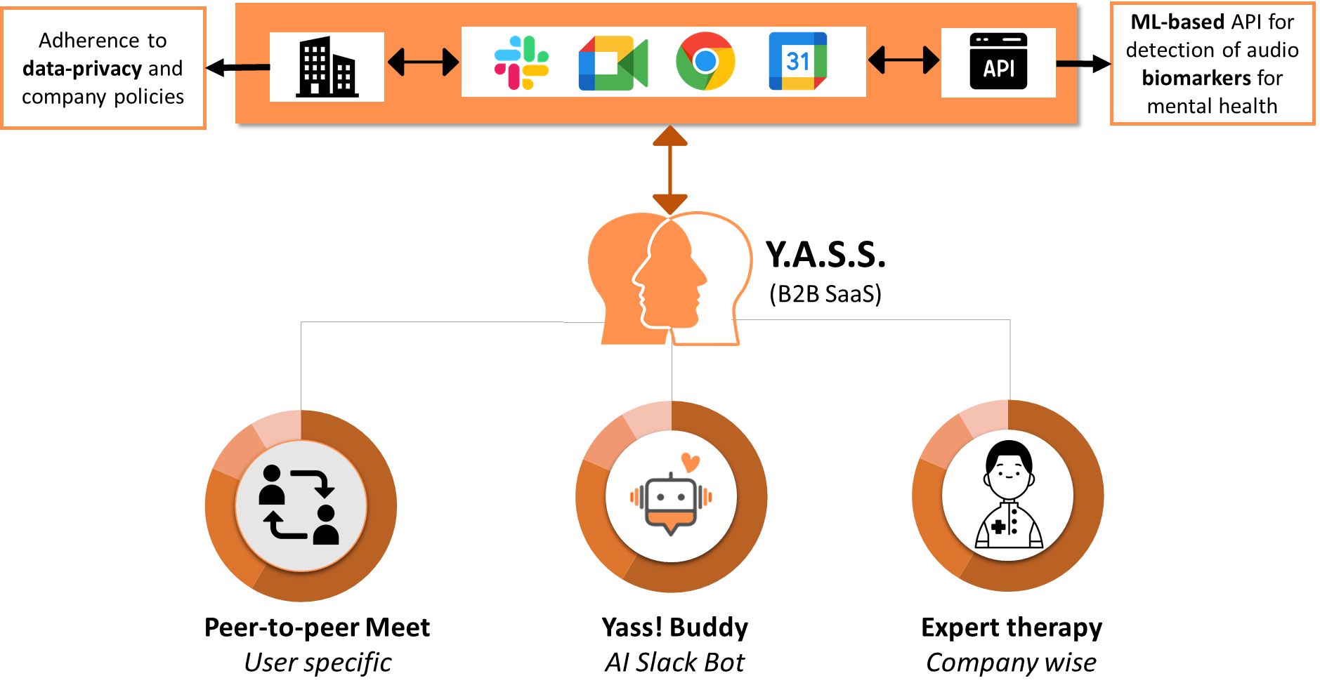
OUR SOLUTION
DEMO
API: https://www.receptiviti.com/

Slide 5


Slide 6


Slide 7



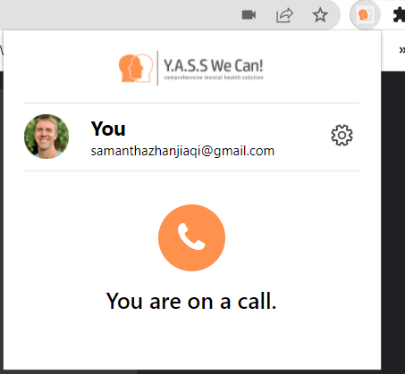

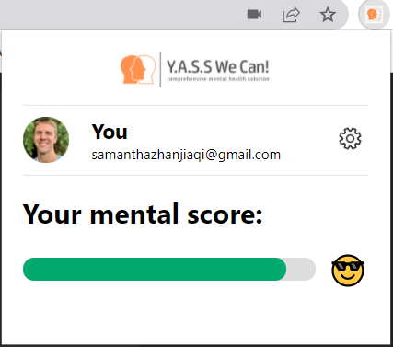

Technical Implementation
Emotional and Cognitive scoring with AI models trained with open data using expert's model.
API CALLS
{
"dictionary_measures": {
"anger": 0.2553398058252427,
"calmness": 0.0970873786407767,
"joy": 0.019417475728155338,
"sadness": 0.02912621359223301
………
}
}
Do you realize what time it is? How many times do I have to ask...
Transcribe call
Client Info
- Email
- Unique account identifier
Meeting status
- Meeting start
- End
- Transcript
Notification pushing
Temporal data storage
+
Information extraction
https://github.com/Samantha-Zhan/YASS-Mental-App

Slide 8
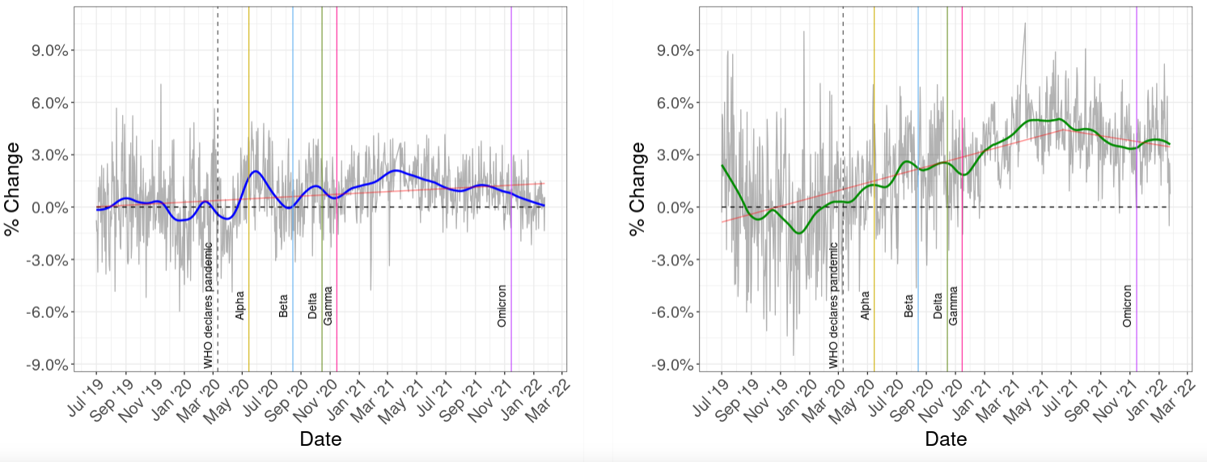


Technical Implementation
API CALLS
Transcribe call
[TBD]
Historic data storage and analysis.
Catch the trend early!
Temporal data storage
+
Information extraction
Extract data for
personalized service

Slide 9





COMPETITIVE ANALYSIS
WYSA
PLUMM
LYRA HEALTH
Y.A.S.S!
Evaluation based on text
Connect with Psychologist
Evaluate health of multiple individuals in a virtual meeting

Slide 10
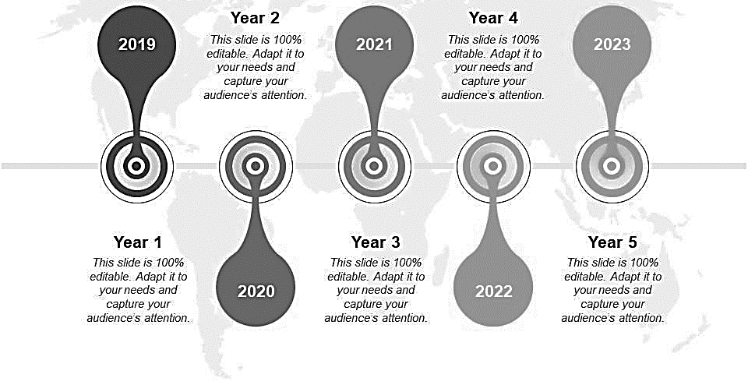
BUSINESS PLAN
2022
Enhancing Model based on voice data – amplitude, frequency, etc
Team size: 11
Revenue: $1M
Grant: $500K
2024
Scale up
Team size: 280
Revenue: $67M
Profit: $31M
2026
Year 6 & Beyond
Data Monetisation
Terminal Value: $448M
International Expansion
MVP based on existing open data
Team size: HTG team members
Revenue: $100K
Grant: $400K
Machine Learning capabilities to see effectiveness of action plan
Team size: 35
Revenue: $12M
Profit: $6M
Scale up
Team size: 720
Revenue: $150M
Profit: $71M
2023
2025

Slide 11





How?
Revenues
(5 Years)
$
230M
60M
Profit After Tax
42M
Present Value of Free Cash Flow
Digital Marketing
FINANCIALS
5 years
Feet on the Street Salesmen
900K
in Grants
THE ASK
Endorsement from Psychologists,
Publish Papers in Medical Journals, Success Stories in magazines, and create content from experts

Slide 12
FINANCIALS 1/2
Revenue Drivers
 | Revenue Drivers for India
Particulars | 2022 | 2023 | 2024 | 2025 | 2026
Number of companies | 1,300,000 | 1,400,000 | 1,500,000 | 1,600,000 | 1,700,000
Video Call Penetration | 35% | 45% | 55% | 65% | 75%
Companies with VC | 455,000 | 630,000 | 825,000 | 1,040,000 | 1,275,000
Number of schools | 1,500,000 | 1,500,000 | 1,500,000 | 1,500,000 | 1,500,000
Internet penetration | 22% | 25% | 28% | 31% | 34%
Schools with internet | 330,000 | 375,000 | 420,000 | 465,000 | 510,000
Total Addressable Market | 785,000 | 1,005,000 | 1,245,000 | 1,505,000 | 1,785,000
Market Penetration | 0.01% | 0.10% | 1.00% | 5.00% | 10.00%
Number of customers | 79 | 1005 | 12450 | 75250 | 178500
 | Revenue Drivers for China
Particulars | 2022 | 2023 | 2024 | 2025 | 2026
Number of companies | 24,000,000 | 26,000,000 | 28,000,000 | 30,000,000 | 32,000,000
Video Call Penetration | 75% | 77.5% | 80% | 82.5% | 85%
Companies with VC | 18,000,000 | 20,150,000 | 22,400,000 | 24,750,000 | 27,200,000
Number of schools | 514,000 | 514,000 | 514,000 | 514,000 | 514,000
Video call penetration | 95% | 96% | 97% | 98% | 99%
Schools with internet | 488,300 | 493,440 | 498,580 | 503,720 | 508,860
Total Addressable Market | 18,488,300 | 20,643,440 | 22,898,580 | 25,253,720 | 27,708,860
Market Penetration | 0.01% | 0.10% | 1.00% | 5.00% | 10.00%
Number of customers | 1849 | 20643 | 228986 | 1262686 | 2770886
Number of customers from the two countries | 1927 | 21648 | 241436 | 1337936 | 2949386
Revenues | 96,366.50 | 1,082,422.00 | 12,071,790.00 | 66,896,800.00 | 147,469,300.00
Notes
- Price point for India and China, the two focus markets: $50/annum
- Price point for Lebanon & other countries facing economic or humanitarian crises: Free

Slide 13
FINANCIALS 2/2
Cost Model
Particulars | 2022 | 2023 | 2024 | 2025 | 2026
Revenues | 100,000 | 1,000,000 | 12,000,000 | 67,000,000 | 150,000,000
Fixed Costs
Business Executives | 100,000 | 200,000 | 500,000 | 5,000,000 | 10,000,000
Medical Expert | 100,000 | 200,000 | 500,000 | 2,000,000 | 10,000,000
Programmer | 200,000 | 400,000 | 1,000,000 | 10,000,000 | 25,000,000
ML experts | 0 | 100,000 | 1,000,000 | 10,000,000 | 25,000,000
Admin costs | 0 | 100,000 | 250,000 | 500,000 | 1,000,000
Amortisation (laptops, home office, etc) |  | 200,000 | 400,000 | 2,000,000 | 5,000,000
Variable costs
Server & API | 1000 | 100,000 | 500,000 | 1,000,000 | 2,000,000
Advertising, Marketing & Sales commissions | 99,000 | 200,000 | 2,000,000 | 5,000,000 | 1,000,000
Funding/Grants required | 400,000 | 500,000
Profit before taxes | 0 | 0 | 5,850,000 | 31,500,000 | 71,000,000
Operating Margin % | 0 | 0 | 49% | 47% | 47%
Profit after taxes (45%) |  |  | 3,217,500 | 17,325,000 | 39,050,000
Present Value | 0 | 0 | 2,554,155 | 12,734,392 | 26,576,774
Terminal Value | 488,125,000
Notes
- Advertising, Marketing & Sales commissions will be paid directly to agencies.
- There will be no travel or rent expenses due to complete work from home model.

Slide 14
SOCIETAL IMPACT
$1.3T
$200B
Assumptions:
Mental Health Impact of 10% addressed in India and China
Mental Health Impact of 50% addressed in other developing countries
Potential to help 300 million people
Global GDP impacted by Mental Health per annum from 2026 to 2030
Global GDP impacted by Yass! Per annum from 2026 to 2030

Slide 15
THANK YOU! Any Questions?

Slide 16
APPENDIX

Slide 17


PROBLEM STATEMENT DETAILS
LEBANON
People don’t realize that they are suffering mentally
17%
Population
90%
No Treatment
People realize they are suffering, but don’t seek out help
INDIA
CHINA
Lack of awareness and empathy to understand others’ mental health
56 Mn
54 Mn
Depression
38 Mn
Anxiety Disorders
41 Mn
1/4th of the World's Population experience mental health illness

Slide 18
SCALE OF THE PROBLEM
Industries affected by Mental Health
Relationship with theme guides this year:
51% of tech professionals have been diagnosed with a mental health condition
71% said productivity is affected by a mental health issue
57% of tech industry employees reported burnout
I
Theme: Health and Humanity,
Subtheme: Accessible Mental and Physical Healthcare
“Better identify global health threats by improving diagnostic measures and the quality of preventative actions.”
TECH
II
UN SDG #3 Good Health & Well Being
The pandemic has halted or reversed progress in health and shortened life expectancy. A decade of progress in reproductive, maternal and child health could be stalled or reversed by COVID-19. The goal of good health & well-being is to ensure healthy lives and promote well-being for all at all ages.
47% faced deteriorating mental health
91% found working from home to be a source of stress
32% of younger employees harbored a worse opinion
CONSULTING
III
“The enjoyment of the highest attainable standard of health is one of the fundamental rights of every human being without distinction of race, religion, political belief, economic or social condition” – Constitution of the World Health Organization
93% of health care workers were experiencing stress
86% reported experiencing anxiety
76% reported exhaustion and burnout
HEALTHCARE

Slide 19
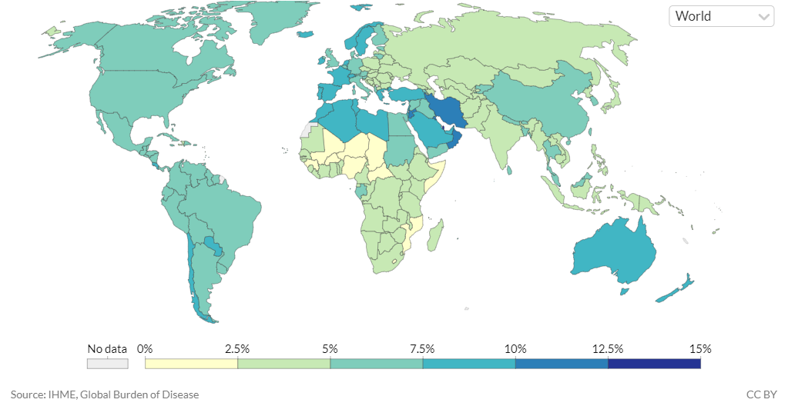
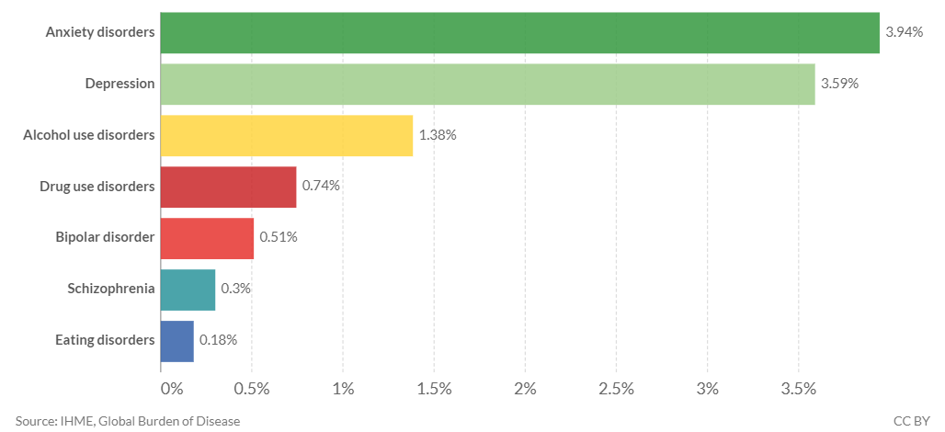
CONTEXT OF THE PROBLEM
Mental Health & Workspace
US $1
Put into treatment of common mental disorders
US $1 Trillion
Loss in Global Productivity due to Mental Health
More than 5%
US $4
Return in improved health and productivity
Of global disease burden as of 2019
Mental Illness as a share of disease burden has been on a rising trend since the past 2 decades across the globe.
Anxiety disorders and Depression are the leading causes for mental health illness globally.

Slide 20
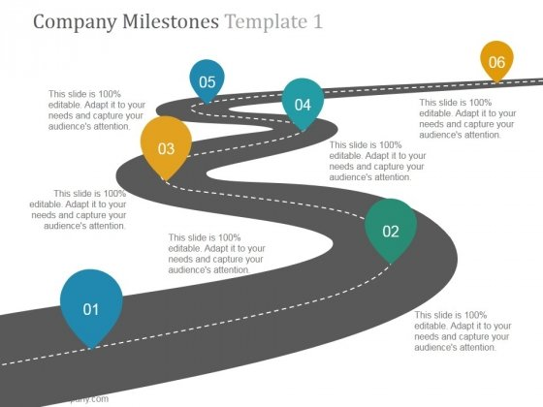
HISTORY OF THE PROBLEM
Milestones for Mental Health Diagnosis
2010: Inclusion of mental health in affordable healthcare act in US
1992: Mental Health Day, Remove Stigma associated with mental health, awareness
1950s:
Telemedicine for Mental Health
1900s: Psychiatry established as a medical and academic field
1898: Local Government Act – trained nurses in mental health
1800s: Public Asylum

Slide 21





USE CASES
THEY HAVE A COMMON PROBLEM
JEFF
SANDY
A 45 YR OLD CEO
A 25 YR OLD SCHOOL TEACHER
THEY ARE WORRIED ABOUT PEOPLE THEY CARE ABOUT
But
DON’T KNOW IF THEY REALLY SHOULD BE
ANDY
CASSY
A 17 YR OLD
CONCERNED FRIEND
A 65 YR OLD CONCERNED MOTHER

Slide 22


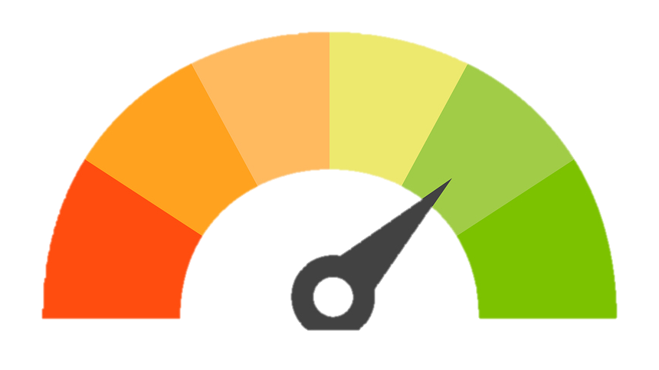

SOLUTION
Solution proposed:
Passive mental health diagnosis of consenting individuals in social virtual events
Captures Audio. Biomarkers such as amplitude, pitch, used to determine mental health
Data Analytics to benchmark mental health of best companies, industry wise
Features:
Library built from Open Data available on words/emoticons association with temperament
Does not invade privacy, security or civic liberty of individuals
Simple Plug-in in chrome
Monitors all members in a Google Meets call
Monitors mental health for each member in the call using relevant biomarkers
Provide an end-to-end comprehensive support to those with low score

Slide 23
BUSINESS STRATEGY
We expend the team’s focus and energies on
Coding
Business Strategy
Identifying use cases
Information providing general Action Plan
Extension Subscription
Digital Marketing
 | Business Model
B2B Developed and Advanced developing countries | Subscription, Paid
B2B developing countries and those under economic or humanitarian crisis | Free
B2C | Free, limited users
Scale more video apps
(Anonymous) Data Monetisation: Analytics comparing different companies

Slide 24
T.A.M
100 M
MARKET SIZE – B2C
Zoom 300 million
Google Meet 100 million .
Microsoft Teams 50 million
Cisco WebEx 60 million
Skype 40 million
P.A.M
570 M
(Daily number of users)
S.A.M
10 M
S.O.M
1 M
P.A.M.: Potentially Addressable Market: Top 5 Video Apps
T.A.M.: Total Addressable Market: Google Meet
S.A.M.: Serviceable Addressable Market
S.O.M.: Serviceable Obtainable Market
Market Penetration 1st year @ 1% of S.O.M
10 K

Slide 25

VIDEO CALL (COMPLEMENT TO OUR GROWTH)
43% of remote and in-house teams use a video conferencing solution.
78% of corporate companies use video calling software.
83% of businesses with over 250 employees are likely to purchase video calling tools.
27% of small businesses are likely to buy video calling tools.
86% of companies conduct employee interviews over video calls.
73% of education professionals say video conferencing will decrease student dropouts

Slide 26
PRODUCT ROADMAP
Q2 2022
Q3 2022
Q4 2022
Q1 2023
Google Chrome Extension for Google Meet
Google Chrome Extension for Zoom
Google Chrome extension for Microsoft Teams
Microsoft Teams app

Slide 27
CALCULATIONS & ASSUMPTIONS
Social Impact
China GDP in 2030: $31T
India GDP in 2030: $12T
World GDP: $109T
Developing Countries GDP share in 2030: 60%
China and India GDP share: 40%
Other developing countries: 20%
World GPD now: $80T
Mental Health affected now: $1T
Mental Health affected in 2030: $1.4T
Impact due to MH from 2026 to 2030 (avg: 1.3T): $6.5T
Mental health issues solved by our application with 10% market penetration in India and China and 50% market penetration in other developing countries (considering that it is free): 0.056T + 0.14T =0.196T or $196B
Impact over 5 years: $1T
Financials
Employees based out of India and China including programmers, sales executives
Targeting only 50% of Private Schools in China by 2026
We will maintain 10% market share in India & China and 50% market share in other developing countries from 2026 onwards
Numbers
8 billion people
6 Billion in developing countries
2.5 Billion people in India and China having 200 million with mental health issues
We address 10% of this 200 Million
10% in developing countries suffering from Mental Health issues
600 million people in the developing world suffering from Mental Health Issue – we address 50% of this population
Impact – 300 million people in the developing world

